Slide 1
Building Dementia
Awareness in
Health/Dental Care
Michelle Barclay, President and Co-founder, The Barclay Group
Colleen Fritsch, Trainer, Trellis
Jen Rooney, ACT on Alzheimer’s Program Developer, Trellis

Slide 2
Dementia Friendly Dental Practices
Funding for the project is from the Delta Dental of Minnesota Foundation and the University of Minnesota Academic Health Center’s HRSA-funded Geriatric Workforce Enhancement Program.

Slide 3
Two Trainings
Basic Training (Dementia Friendly @ Work – Healthcare)
Information Session – 1 hour
Optional Case Study – ½ hour
Designed for ALL staff – clinical, reception, financial, maintenance, etc.
Advanced Training
Information Session(s) – 2-6 hours
Non-optional Case Studies
Designed for Clinical Staff – dentists, hygienists, therapists, assistants

Slide 4
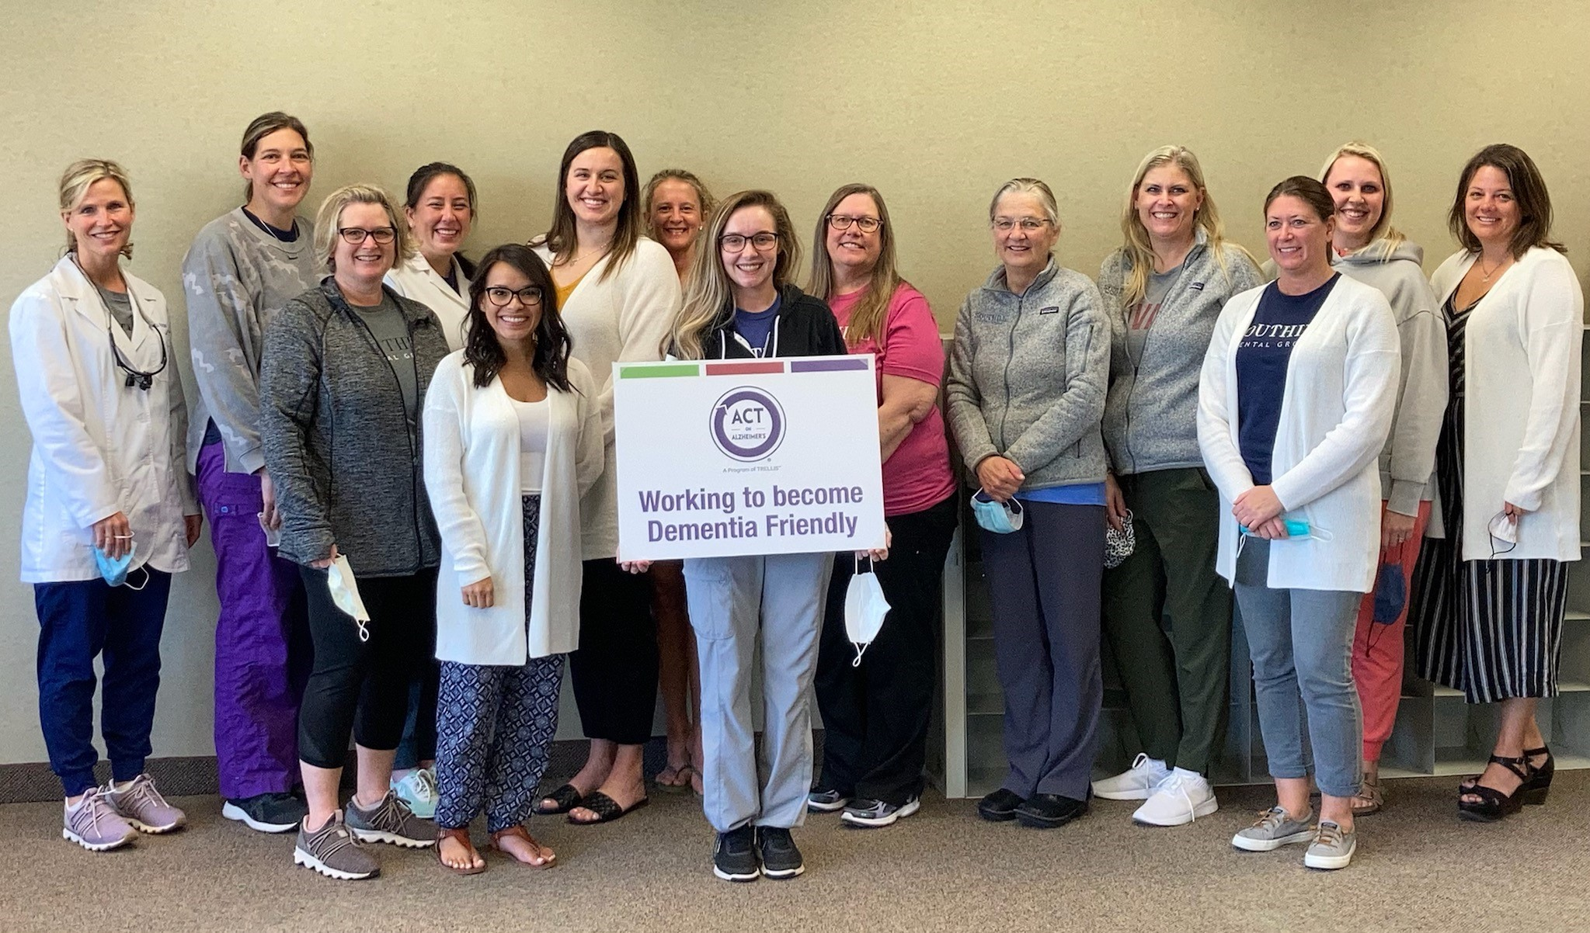
Basic Training Pilot
Urban Site: Southhill Dental Group, Stillwater, May 12

Slide 5
Confirmed Sites
PILOT SITES - Completed
Southhill Dental Group – Stillwater – May 12
South Main Dental – Cambridge – June 10
PHASE ONE – August through October
Forever Smiles – Arlington – Aug. 31
Lake Sarah Dental – Rockford – Sept. 7- Zoom
Dental Health Care Center – Richfield – Sept. 9
Piedmont Heights Dental – Duluth – Sept. 17
River Pines Dental – Hastings – Sept. 28
Edlund Dental – St. Paul – Sept. 29
Dakota Dental & Wellness – Apple Valley – Oct. 6
Northeast Dental Wellness – Mpls – Oct. 12
Shetek Dental Care – Slayton – Oct. 13
Sibley Dental Suite– Litchfield – Oct. 19

Slide 6
Additional Planned Programs
April 29, 2022: Minnesota Dental Association Star of the North Meeting, River Centre, St. Paul, MN
“Dementia Friendly @ Work for Healthcare”
  Colleen Fritsch, Trellis
“Dementia Friendly Dental Practice: Things to Remember When Patients Forget”
Stephen Shuman, DDS, MS, UMN School of Dentistry
May 6, 2022: UMN Continuing Dental Education Spring Core Competency Day, MN Landscape Arboretum, Chanhassen, MN
“Creating Dementia-friendly Dental Practices and Communities: A Panel Discussion”
Michelle Barclay, MA, Stephen Shuman, DDS, MS,
Dawn Simonson, MPA, Terry Barclay, PhD

Slide 7
TIMELINE FOR BASIC TRAINING
Phase One ends October 31
Volunteers can begin training now!
Potential trainers watch virtual trainings
Webinar coming in November
When training is complete, ask to be certified
Dental practices can begin signing up now!
Dental practices and trainer matches begin in December
Trainings around the state will launch January 2022

Slide 8
We Need Your Help!
Volunteer trainers
Dental practices to sign up for trainings
Community resources to identify themselves
Promote this in your own community
actonalz.org/Community Resources/Dementia Friendly @ Work for Healthcare
Medical clinics are next!

Slide 9
Stay in the know
Sign up for We ACT e-news
actonalz.org/signup
Thank you!

